Slide 1
Incorporating Digital Competencies with Media Literacy Pedagogies
Case Study: The Media and Digital Literacy Academy of Beirut (MDLAB)
Lubna Maaliki
The American University of Beirut (AUB)
Notes:
Video

Slide 2
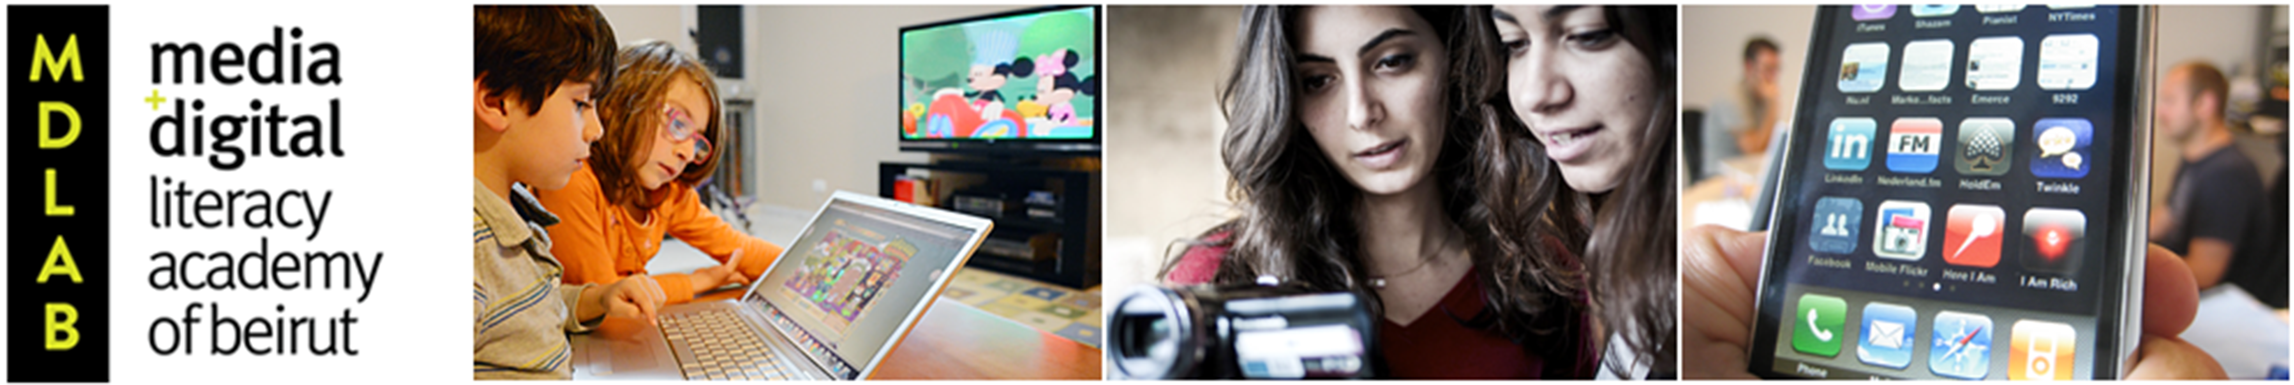
MDLAB aims to advance digital and media literacy education in the Arab region by training a generation of teachers and scholars and developing locally rooted curricula. (video 1)
Notes:
MDLAB offers graduate students and academics a unique opportunity to study media and digital literacy with leading Arab and international experts during two summer weeks.
Lectures
Digital workshops
Cultural excursions
Social and cultural activities
Panel discussions

Slide 3
Topics covered at MDLAB:
Media and Human Rights
Media, Gender, and Body Image
Power of Images
Media portrayal of race and identity
Arab Media Ownership
News construction
Media habits, privacy, and safety
Elements of Propaganda
Applied Digital Activities

Slide 4
Digital Skills covered at MDLAB
Photo editing (photoshop and Pixlr)
Blogging (wordpress)
Podcasting (sound cloud, audacity)
Video Editing (premiere)
Digital Curation (storify)
Creative commons (Flickr+)
Instagram
Data analysis

Slide 5
Why is incorporating digital skills relevant to a media literacy program?
1) An increasing number of industries view digital and social media skills as crucial when hiring new recruits
2) Ubiquity of media messages and technologies
3) Teaching digital skills helps media literacy students become more critical consumers and producers of information

Slide 6
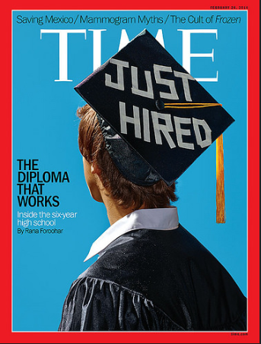
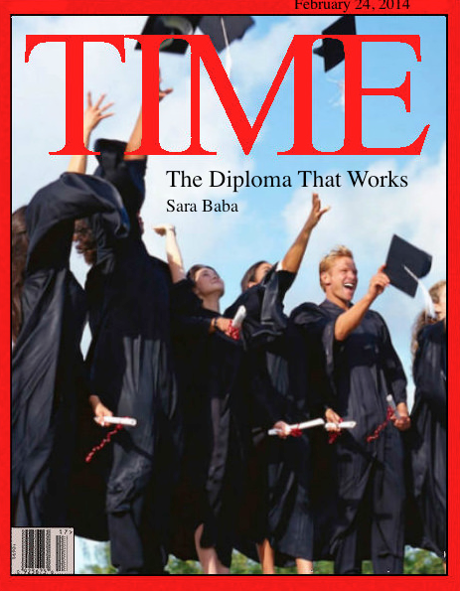
Photo Editing
Original
Alternative

Slide 7

Video Editing
(video 2)
Storify:
https://storify.com/leyalkhalife/al-houthi-s-in-yemen

Slide 8
Challenges
Varying digital skills among participants
Varying language competencies
Offering assignments and workshops that engage all participants
Lack of literature about media and digital literacy in Arabic or catered to the Arab region
Lack of a framework for media literacy teaching methods

Slide 9
Solution
1) Assignment Construction
2) Four guidelines in teaching digital skills:
A) Visual demonstration
B) One-on-one guidance
C) Non-linear exercises
D) Scaffolding
3) Final projects (example: Rumors: https://storify.com/Groupe4/story)
Notes:
Create a clear and explicit link between the lecture, the media literacy critical analysis post, and the digital skills assignment.

Slide 10
Use of social media
The director and the digital squad trainers are always in touch with the participants via Facebook, twitter, and wordpress.
http://mdlab2014.wordpress.com
https://www.facebook.com/mdlab.aub
@Mdlab14

Slide 11
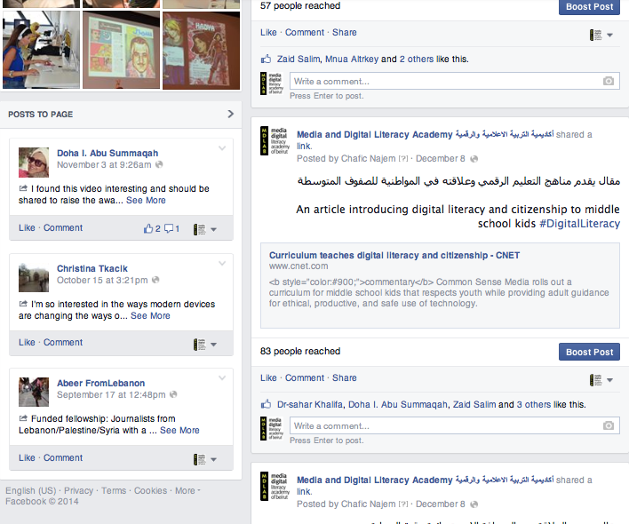
Facebook

Slide 12
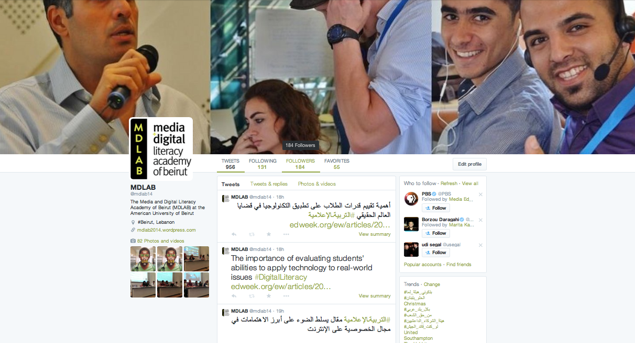
Twitter

Slide 13
Outcome
Build on the critical reading skills among participants
Help participants transition from media consumers into critical producers of information
Final projects allow participants to contribute to the media literacy field
Final projects illustrates if the participants grasped the idea of media literacy and the integration of digital skills or not.

Slide 14
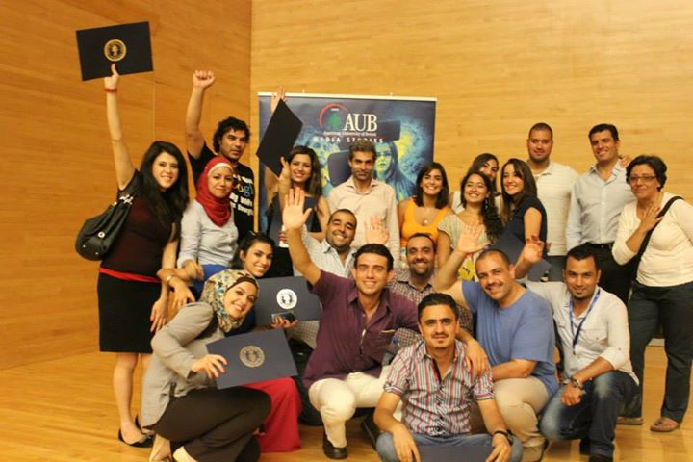
www.aub.edu.lb/mdlab

